Slide 1
Embedded Systems Project : AXI4-lite Prof. W. Fornaciari Prof. D. Zoni Tutor: Andrea Galimberti
Group
Colombi Marco
Corbetta Giorgio
Consonni Cesare

Slide 2
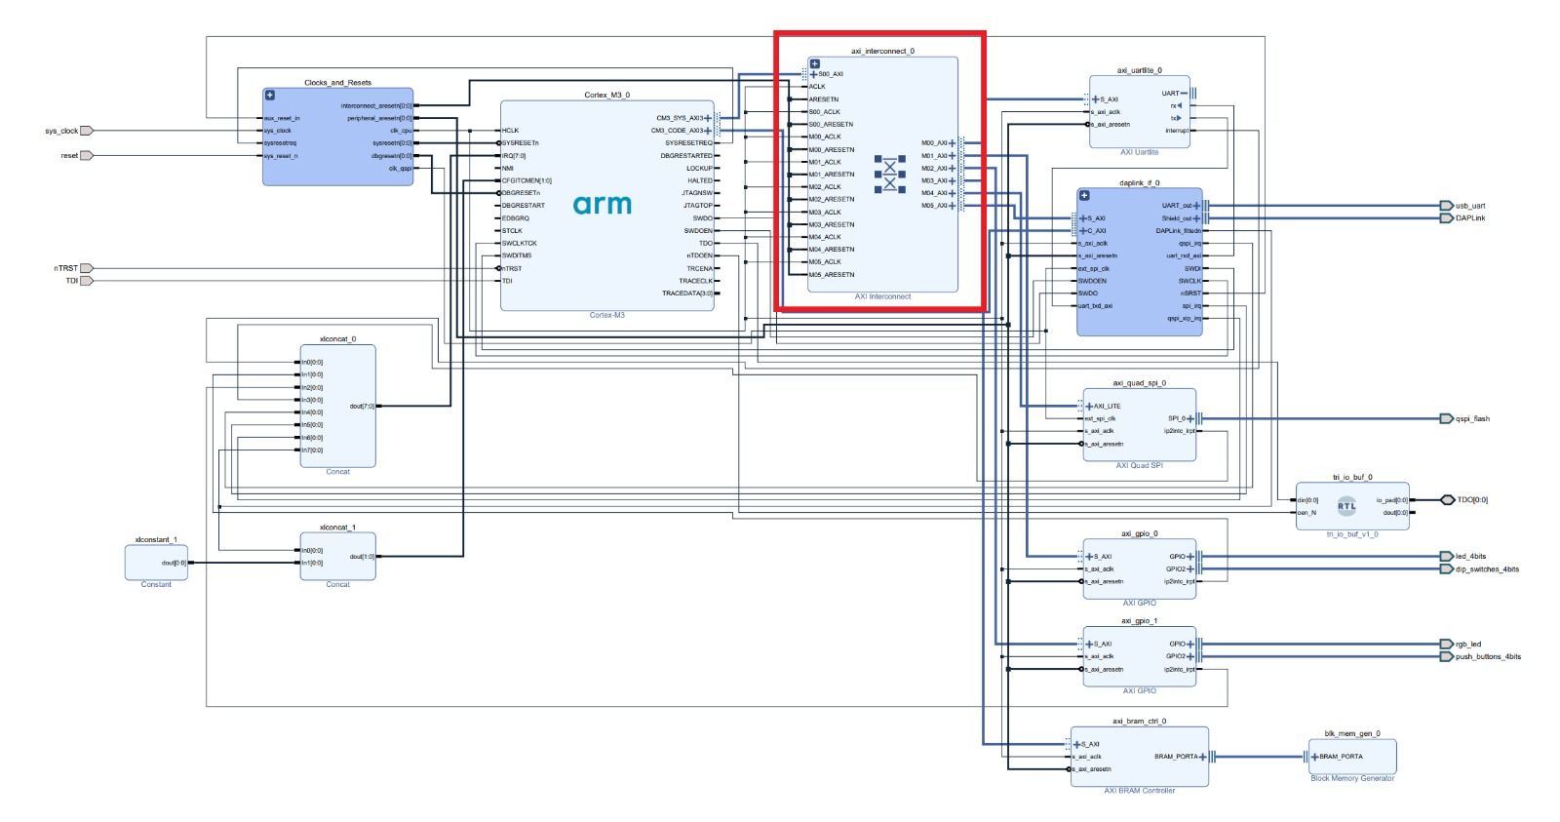

About AXI
AMBA AXI is a parallel communication protocol
multi master
multi slave
High performance
High Frequency
Used (also) inside the processors.
2
Notes:
Course name
Lesson name
© 2000 - Author's name
2

Slide 3
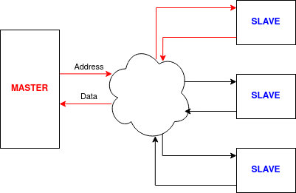
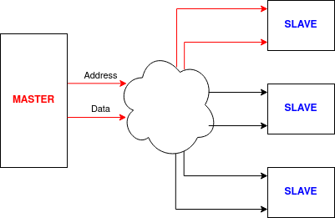
What it does
Two ways to communicate:
Read
Write
AXI has the role to enable such connections
3
Notes:
Course name
Lesson name
© 2000 - Author's name
3

Slide 4
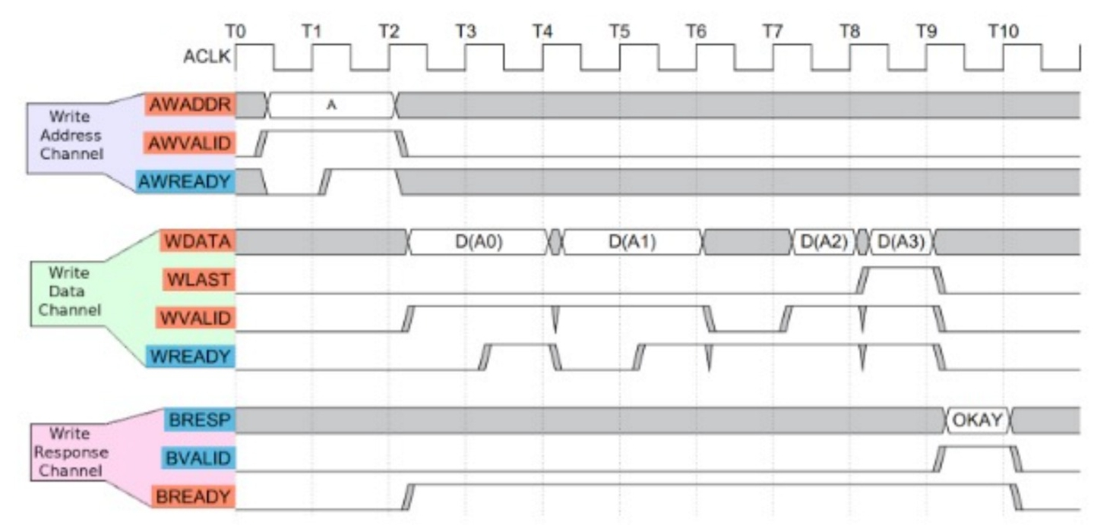
How does it do it
Address mapping
Handshake protocol:
For each line (address, data and BRESP); valid ready resp
4
Notes:
Course name
Lesson name
© 2000 - Author's name
4

Slide 5
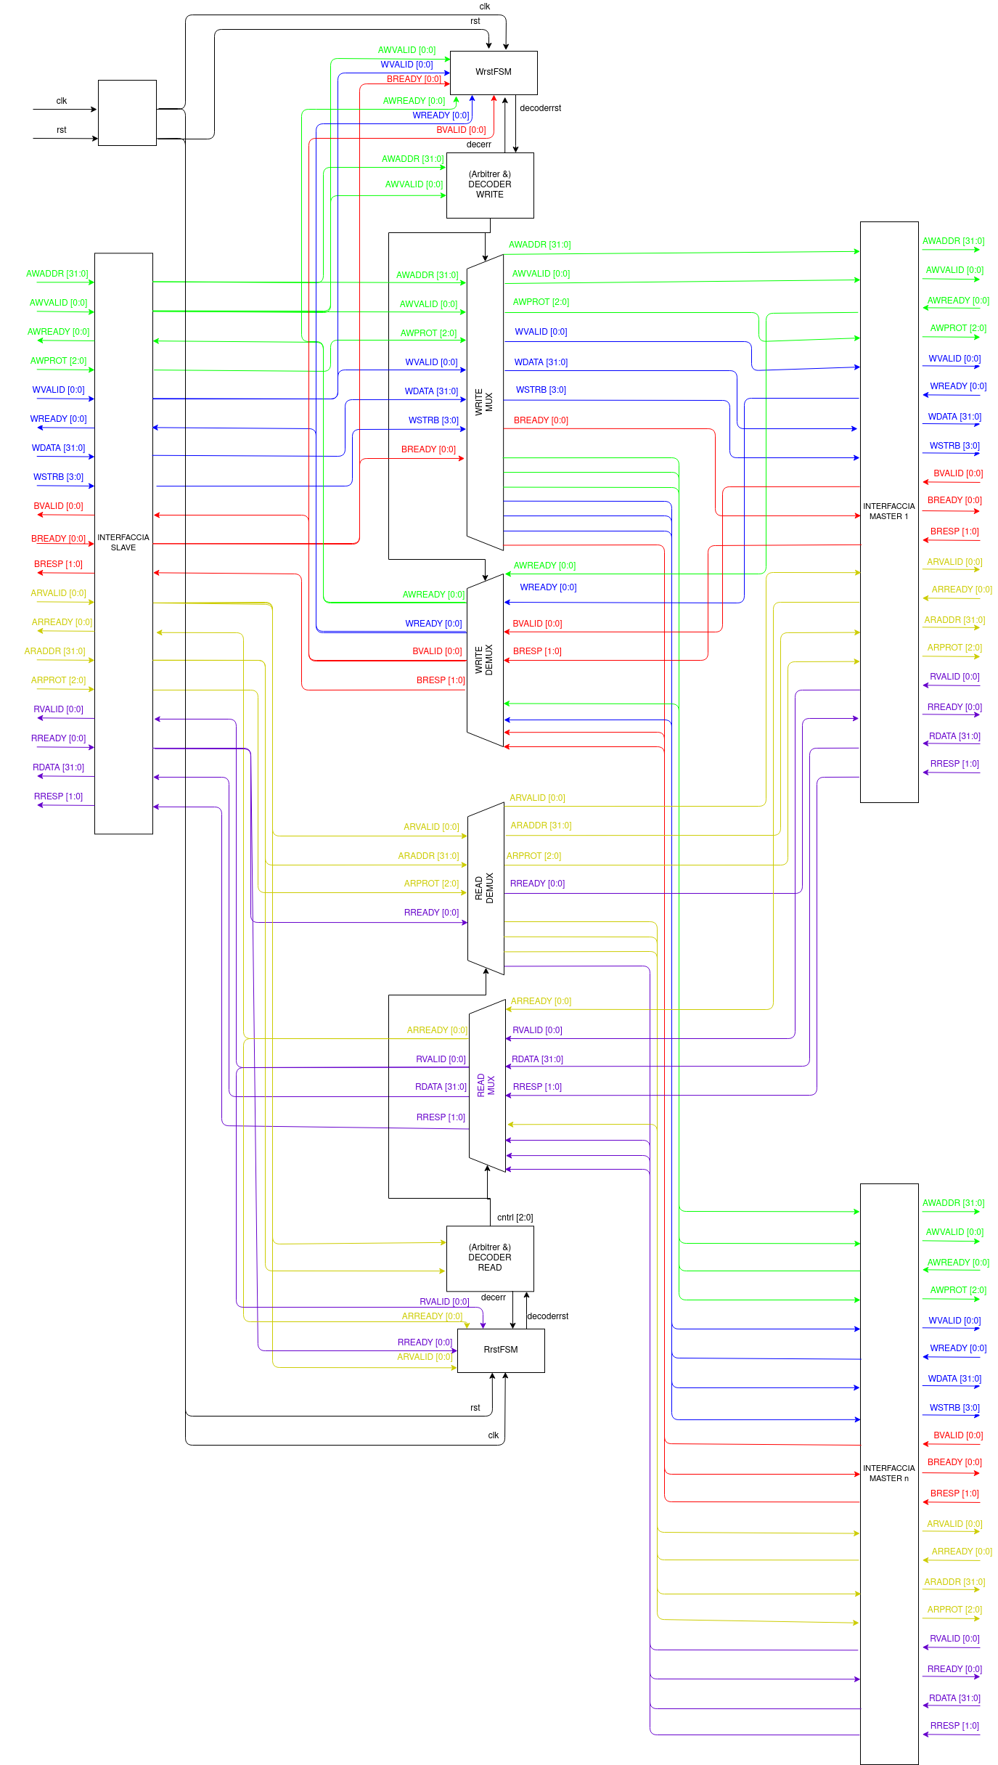
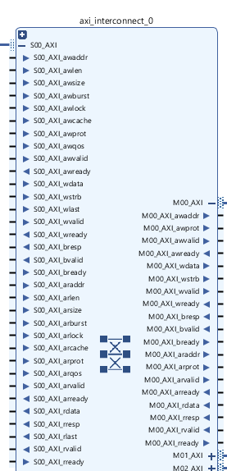
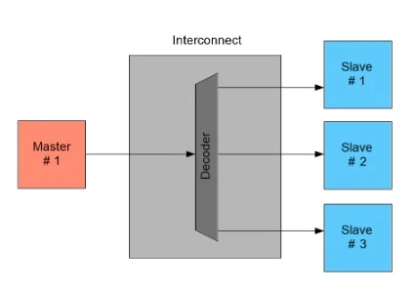
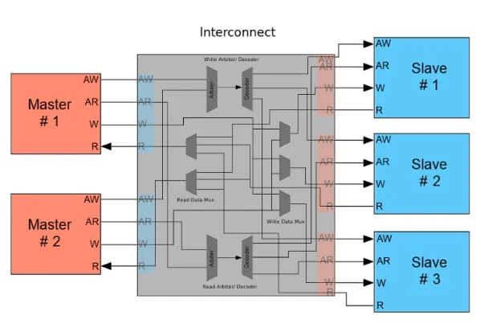
How it’s made
https://www.allaboutcircuits.com
5
Notes:
Course name
Lesson name
© 2000 - Author's name
5

Slide 6
Difference Between AXI(s)
Features of AXI-Lite:
Burst length = 1
Always use full width of the data bus
All accesses are Normal, Non-modifiable, Non-bufferable
Multi-size registers can be implemented
Need In Order transactions
Do not support Quality of Service
Features of AXI:
Burst transaction (AxLEN, AxBURST, xLAST)
Different width of the data bus (AxSIZE)
Different type of accesses (AxLOCK, AxCACHE)
Multi-size registers can be implemented (xSTRB)
Support Out of Order transactions
Support Quality of Service
6
Notes:
Course name
Lesson name
© 2000 - Author's name
6

Slide 7
Let’s break the magic
How to connect
Master to Slave
Slave to Master
The MUX and DEMUX need to be driven in some way… How? Let’s go on
DEMUX
MUX
7
Notes:
Course name
Lesson name
© 2000 - Author's name
7

Slide 8

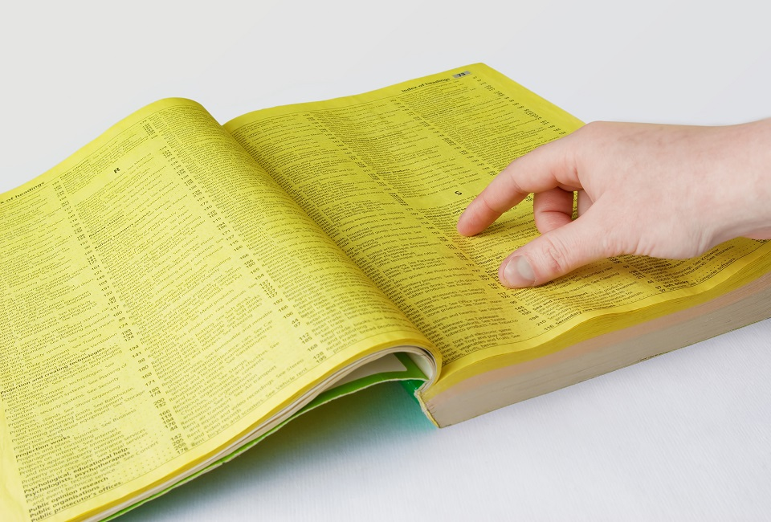
The helm
Who belongs this address to?
DECODER
When is the address valid? When does the connecction end?
FSM
8
Notes:
Course name
Lesson name
© 2000 - Author's name
8

Slide 9
FSM States
ERR STATE
ADDR HS
IDLE
DATA HS
RESET
RESP HS
9
Notes:
Course name
Lesson name
© 2000 - Author's name
9

Slide 10

On the AXI
IDLE
RESP HS
ADDR HS
ERR STATE
DATA HS
Standard Case:
Handshake on Address
Handshake on Data
Handshake on Response
Error Case:
Error on the Decoder
Switching to DE/MUX states
Completing the transaction with resp = 111
10
Notes:
Course name
Lesson name
© 2000 - Author's name
10

Slide 11

The Final Recepit
Finally, to build our AXI we used:
1) Big MUXs and DEMUXs
2) Sequential Circuits (decoder’s mapper)
3) FLIP FLOPS (to keep the signal of decoder)
4) FSM
5)Lot of patience 6) Love q.b.
11
Notes:
Course name
Lesson name
© 2000 - Author's name
11

Slide 12
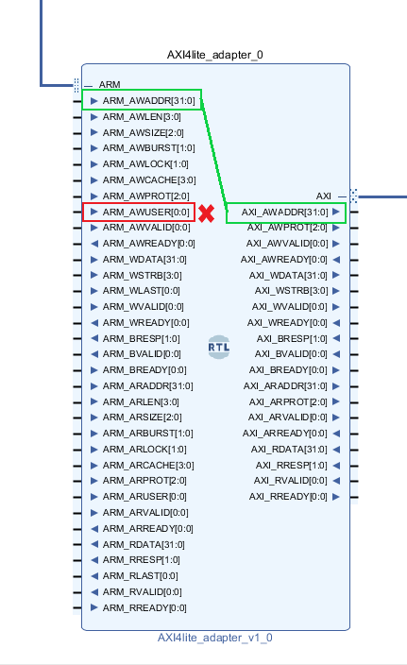

Before connection: protocol adaptation
Simple wire connection for the signals used by both AXI3 and AXI4-lite
Control signals of AXI3 without particular specification, for example:
AxLEN = 0 → no burst lenght
AxSIZE = 2 → data of 32 bit
AxLOCK = 1 → normal access mode
AxUSER = 0 → no usage
Not significant control on RREADY and BREADY

Slide 13
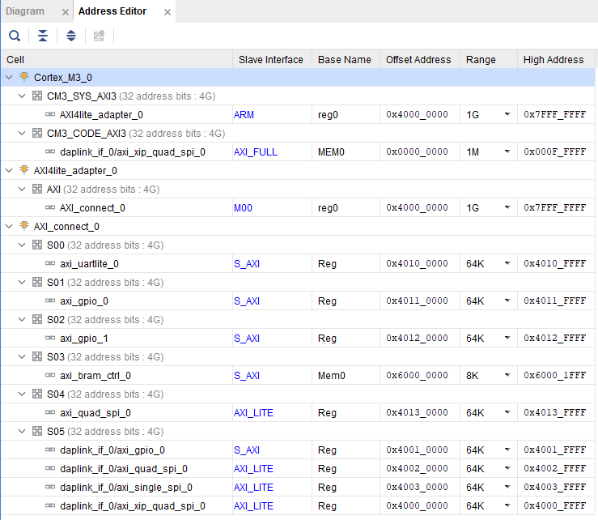
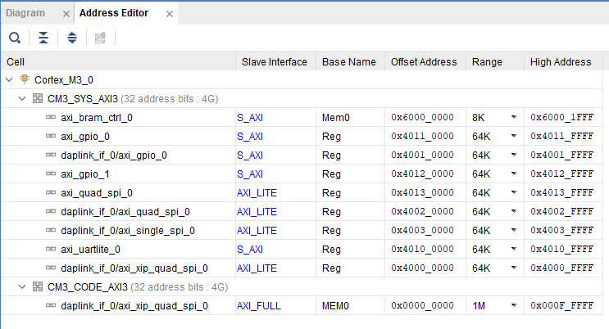
Before connection: mapping addresses
Not only on the decoder but also on the address map

Slide 14
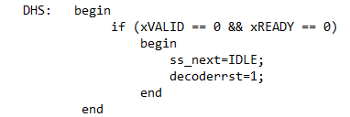
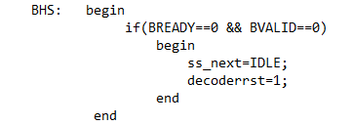
After connection: RREADY and BREADY
RREADY and BREADY always asserted → can’t be used by read and write finite state machine!

Slide 15
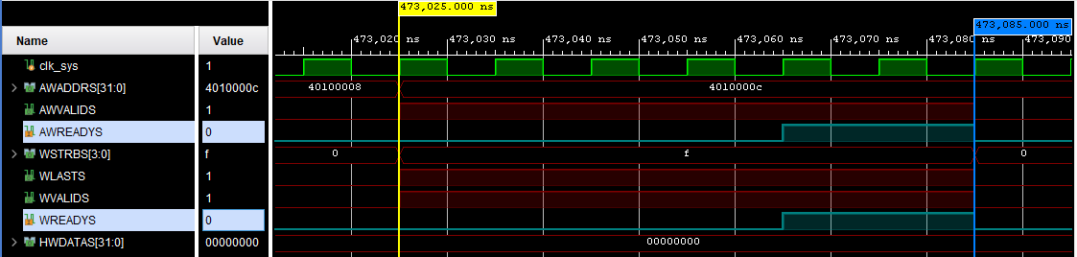
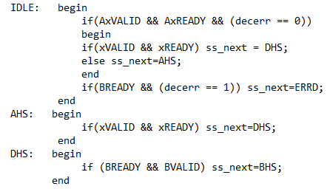
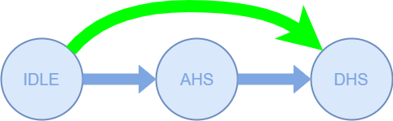
After connection: Write handshake
Slave can answer for both address and data at the same time → AXI can’t stay behind!

Slide 16


Uart decoding
In reverse order with start and end bit
buffer

Slide 17
How we tested it?
How the AXI is:
What we shuld have done:
Create fake Memory and stub our AXI
With an adapter, we put our AXI into the M3, and the simulations had only original or our AXI as differences
BUT
We managed to fit our AXI right inside the processor with no other changes
17
Notes:
Course name
Lesson name
© 2000 - Author's name
17

Slide 18
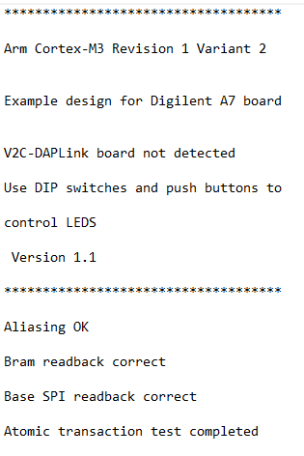
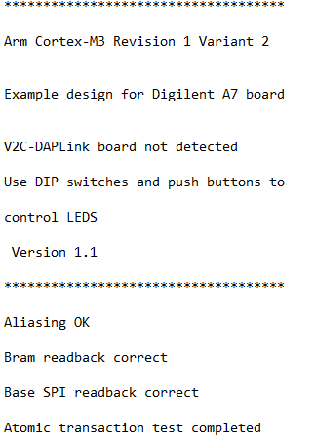
Compare Uart decoding
ARM Design Start
Our AXI

